Slide 1


Data Bases Basics

Slide 2

Please Scan it!

Slide 3

What is a Data base?
A structured collection of data organized for efficient storage, retrieval, and management

Slide 4
Applications that use it
E-Commerce (Amazon, Shopify)
Product Catalog:
Database Tables: products, inventory, reviews, pricing
Joins products with inventory to show "Only 2 left!“
Transaction locks prevent selling the same item twice during flash sales.
Social Media (Instagram, Twitter/X)
Feed Generation:
Joins posts, followers, and likes to personalize your feed.
Healthcare (Electronic Medical Records)
Patient Safety:
Databases enforce constraints like:
"Blood type cannot be NULL before surgery."
"Drug interactions trigger alerts."
Medicine:
Joins patients, doctors, and appointments for virtual visits.
Logistics (FedEx, Uber)
Route Optimization:
Databases process millions of packages + traffic_data to find fastest paths.

Slide 5
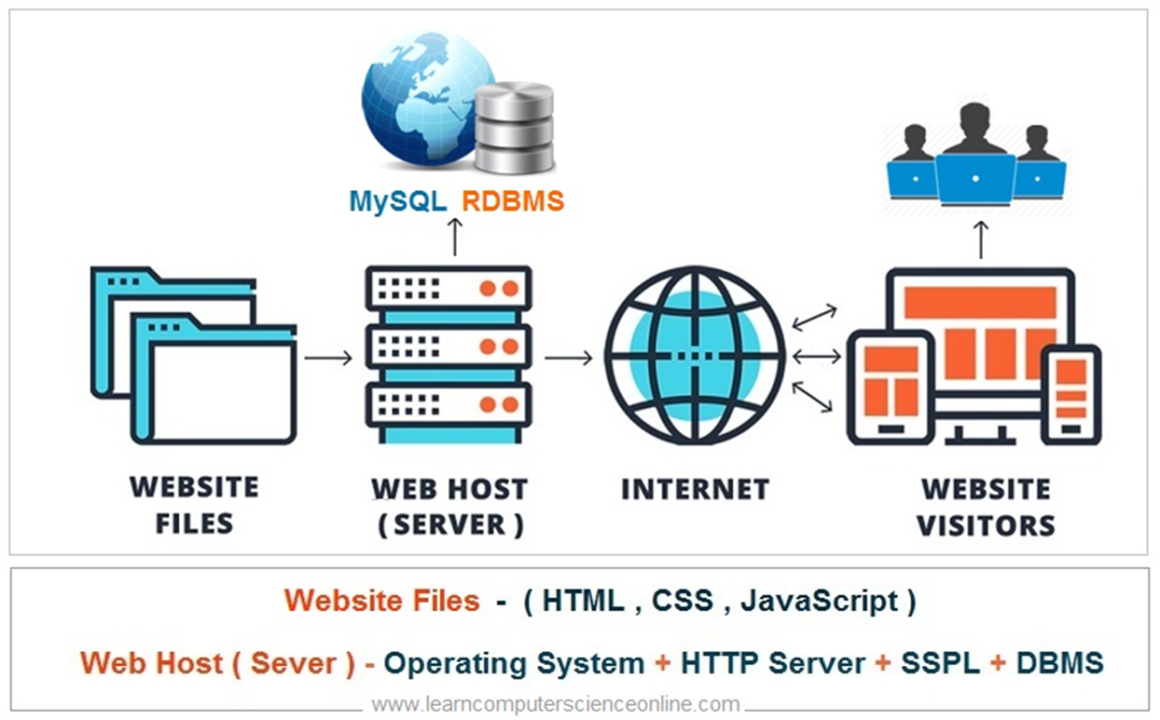
Data base types
Relational Databases (SQL): Tables with rows and columns (MySQL, PostgreSQL, Oracle)
NoSQL Databases: Document, key-value, graph, or wide-column stores (MongoDB, Cassandra, Redis)
NewSQL: Combines SQL reliability with NoSQL scalability

Slide 6
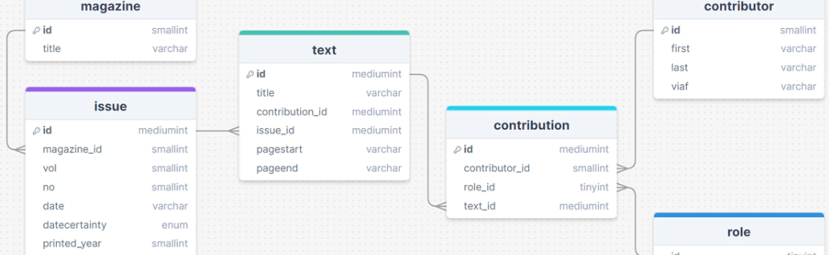
Core Concepts
Tables/Collections: Where data is stored (rows/records in tables, documents in NoSQL)
Fields/Columns: Individual data elements
Primary Key: Unique identifier for each record
Foreign Key: Field that links to another table's primary key

Slide 7
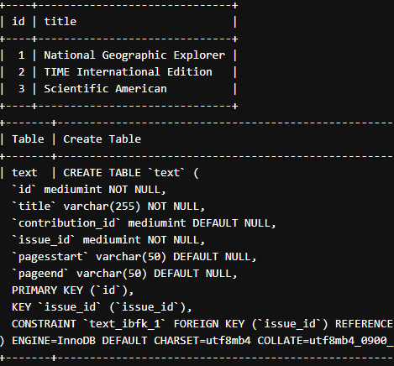
Basic Operations (CRUD)
Create
Create: Insert new data
Read
Read: Query/retrieve data
Update
Update: Modify existing data
Delete
Delete: Remove data

Slide 8
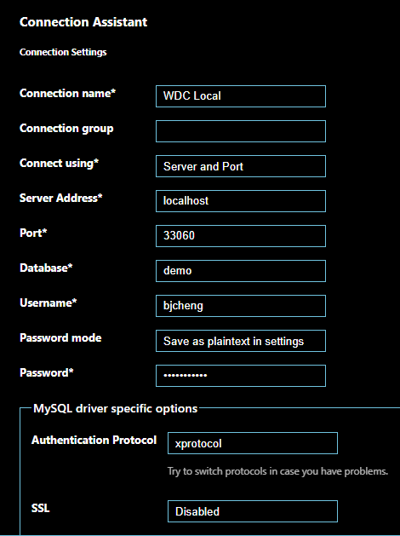

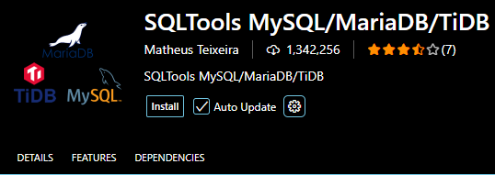
How to set up MySql on VS Code
Open VS code and look for the extensions and type “SQLTools”
Now, we need to connect to a server. on extensions look for
Click on the extension and click on “Add New Connection”
Now let’s create our connection with default options
You can start working on it
If not working, go to: https://onecompiler.com

Slide 9
